Slide 1
Presentation 2
Thinkers

Slide 2
Question 1:
How many distinct patch sizes should we consider?
Do we need to fit patches on every tissue slice to visualize the distribution of patch sizes?

Slide 3
Main Objective
Develop a histogram of all patch sizes used for the 106 tissue slices to determine the modality and distribution of patch sizes we will ultimately use to train our CNN model

Slide 4
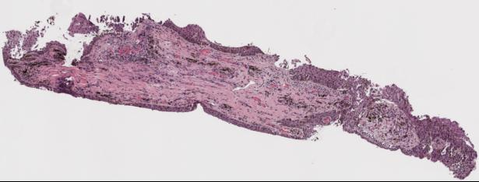
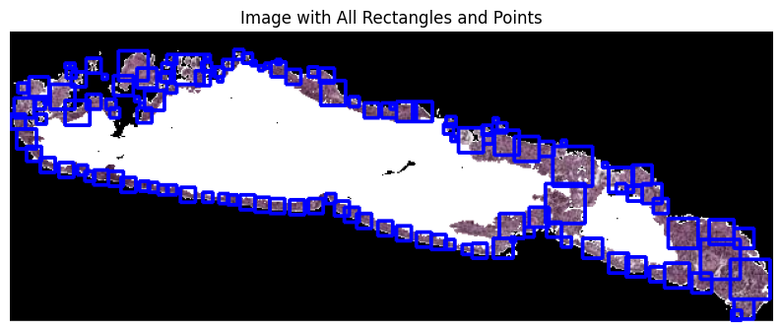
Issues with this algorithm
There is one patch that doesn’t cover entire epithelium (shown below)
Case 89 h1857578B h&e_ROI_2
2. We had to manually edit the ‘initial_size’ parameter in order to have nice looking patches
Notes:
Notes:
This is using Alyssa’s initial patching algorithm
Those two images are not the same slice. Doesn’t really matter bc this is just for demonstration purposes but we can also change the first image to be the right slice

Slide 5
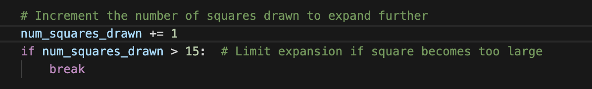
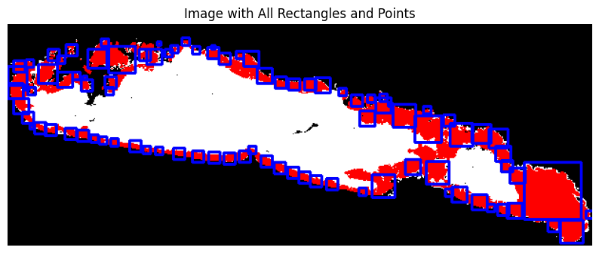
Fixed issue #1 in two ways
increased the num_squares_drawn limit from 7 —> 15
Changed the algorithm to patch on top of the mask instead of the tissue image to avoid issues from black and white pixels in the epithelium
Notes:
Changing num_squares_drawn limit fixed the problem of the patch in the center of the epithelium
Right now we just made the limit big enough to look good on this specific slice but we will probably want to determine it algorithmically in the future to make the patching process both more optimal and more abstractable to other slices

Slide 6
Option to fix issue # 2: Make ‘initial_size’ constant and small
Github link
Downsides
Requires more iterations for the patches to reach the width of the epithelium
Increased complexity?
initial_size = 2

Slide 7
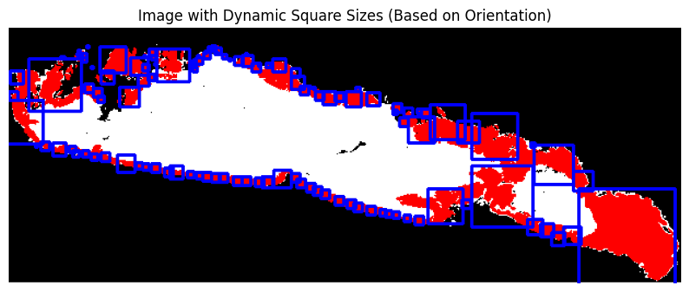
Option to fix issue # 2: Dynamically determine `initial_size`
Github link
initial_size = 2
Initial_size depends on the width of the epithelium,
‘num_squares_drawn’ limited to 15
Notes:
Notes on dynamically changing initial_size
reduce complexity because the first image looks accurate but goes through more iterations of patch size expansion
First image patches are too small? (I personally don’t think this is an issue)
This change is good but the algorithm that determines the parameters still uses arbitrary values which are tuned through trial and error on this specific slice and won’t be perfectly abstractable to other images

Slide 8
Side by Side Comparison
H2114183 h&e_ROI_3

Slide 9
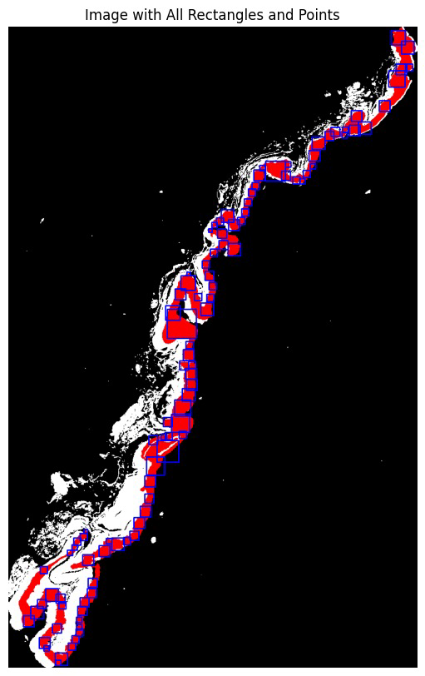
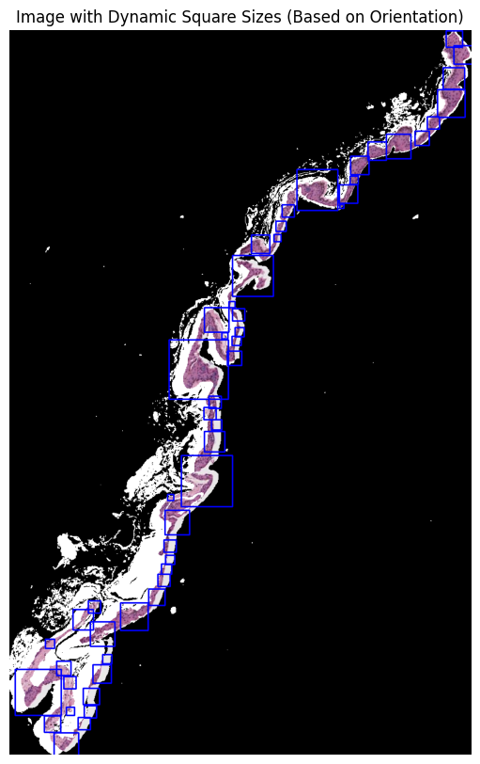
Both generalize on other slices relatively well
H2114183 h&e_ROI_3

Slide 10
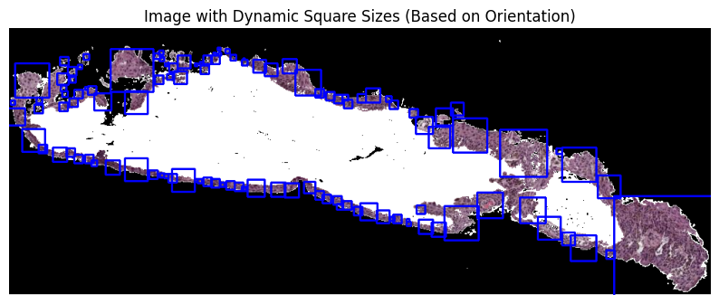
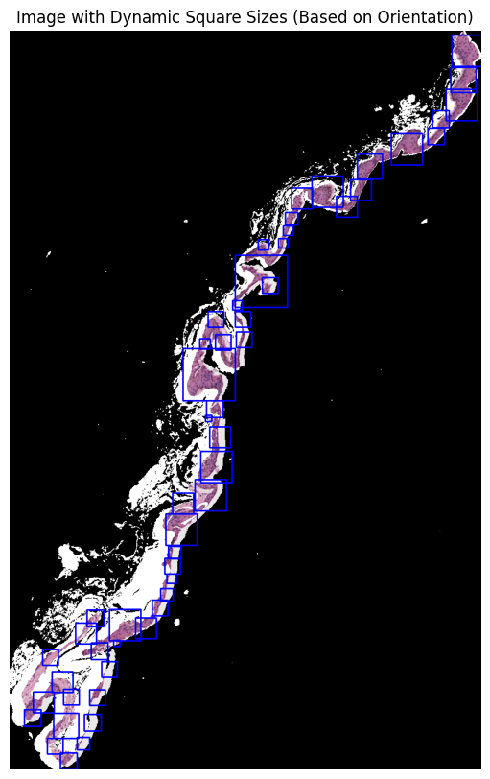
Current downfalls of dynamically changing ‘inital_size` parameter
Very prone to capturing too much non-epithelium
Occasionally prone to blatant overlap
Very sensitive to parameter value changes

Slide 11
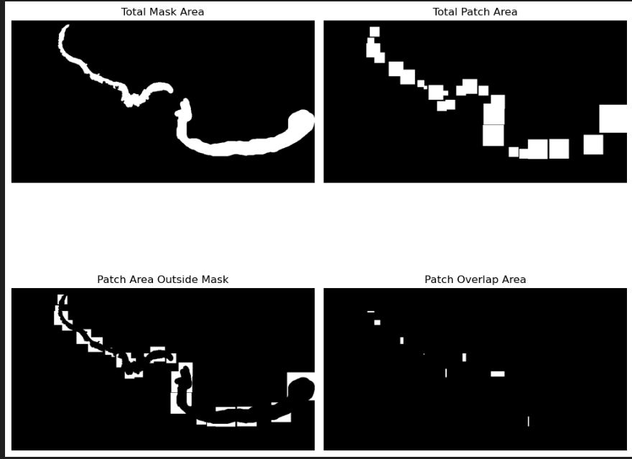
Evaluating our two algorithms
Github link
Metrics:
- % of mask area covered
- % of patch area outside mask
- # of patches
- % patch area overlap
Visualization:

Slide 12
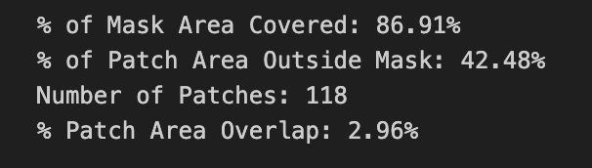
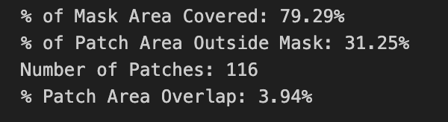
Results of evaluating our algorithms
Took 0.6 seconds to run
Mean size 10.39, mode 8
Took 0.7 seconds to run
Mean size 12.14, mode 8

Slide 13
Next Steps
Alter the code to take a folder as input instead of a single image
Dynamically determine the ‘num_squares_drawn’ limit to be abstractable to other slices
Run the algorithm on more slices to collect data on the distribution of patch sizes
Possibly alter the algorithm to create patches that aren’t parallel to x-y axis

Slide 14
Problems with Alyssa’s Algorithm
Not deterministic enough
Hyperparameter settings might not generalize well
Reliance on balance between `num_squares_drawn`, `balanced_points` ratio range and features we’ve discussed today
Too iterative
Squares grow slowly — if initial size isn’t close to necessary width, it becomes computationally expensive
Certain aspects compromise its own ability to capture width of epithelium
Square stops growing once two of its corners are outside the epithelium
Hyperparameters might prevent a square from growing to the necessary size

Slide 15
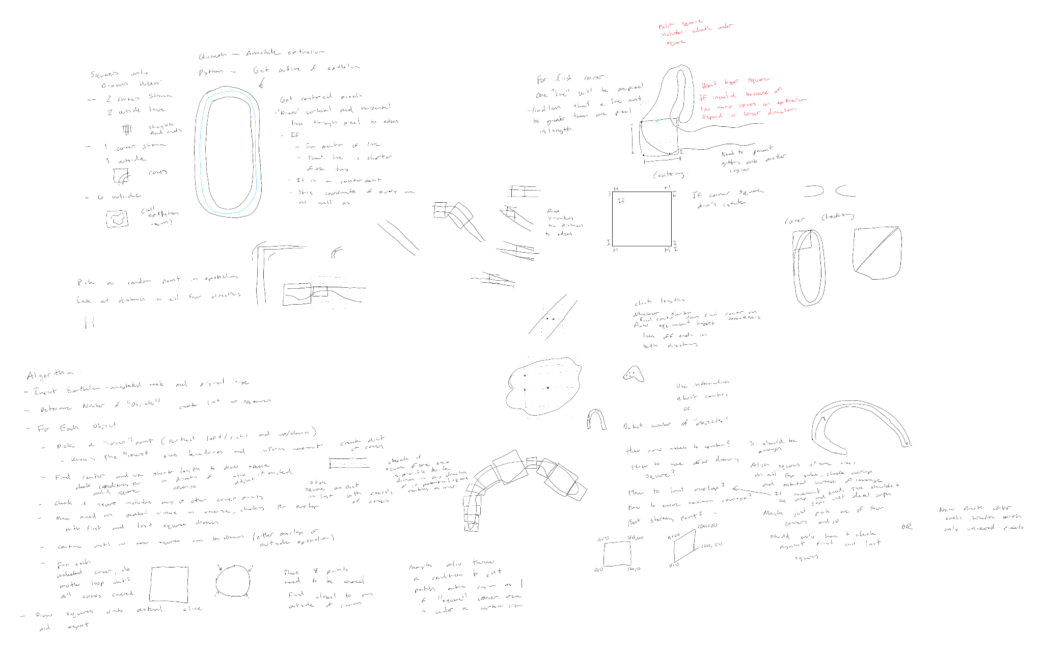
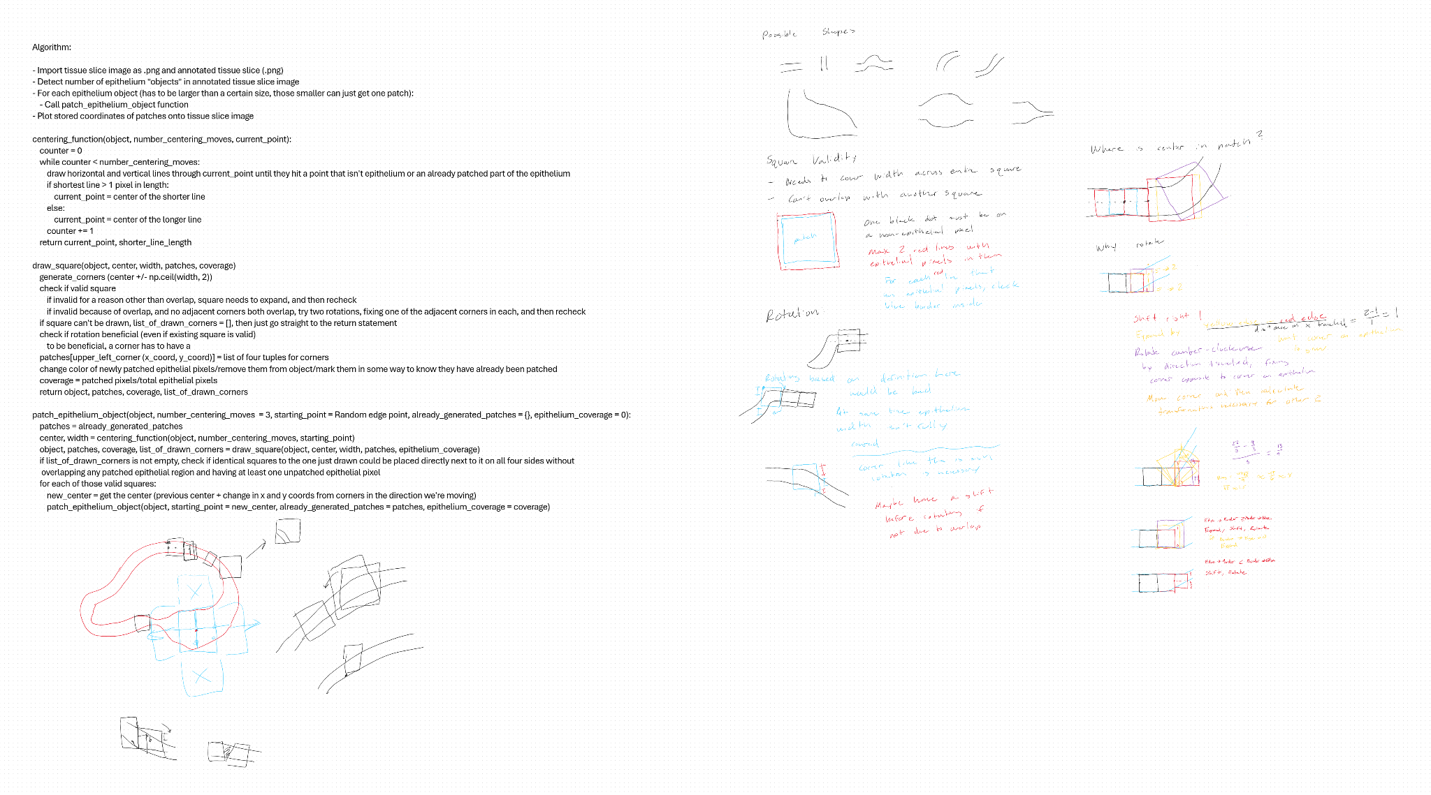
A New Approach
Alyssa’s algorithm makes this question/problem more complex than it should be
Feel like there should be a deterministic, “closed form” solution
screenshots from my notebook over the past few days

Slide 16
This is just a geometry question… kind of
Have a tube-like, sometimes circular, region
Want to cover that region as best we can with shapes
Currently working under three constraints
The shapes have to be square
Squares have to cover entire width of the region in their area
Equilateral property of squares simplifies this problem
Squares shouldn’t overlap
Want patches to be as independent as possible
Maximum epithelium coverage/minimum non-epithelium coverage trade-off

Slide 17
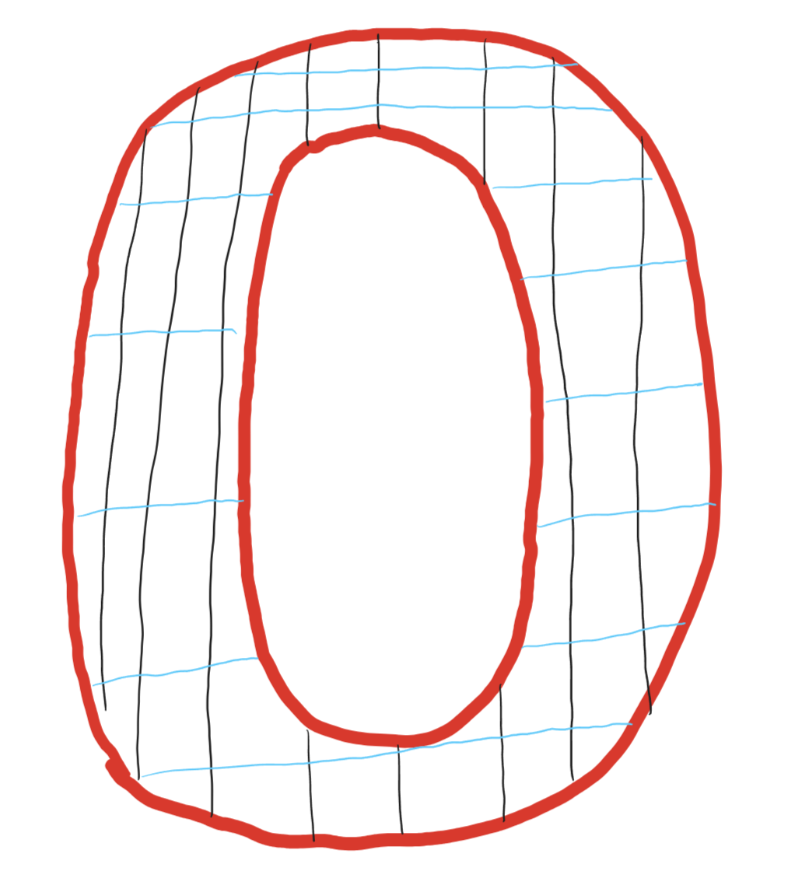
Using the Epithelial Width to Place Squares
Initial idea was grid epithelium
Should be noted: Everything described from here is working on the annotated epithelium, not the original tissue slice
Then divide into regions based on orientation
Shorter line running through a point determines region assignment
What happens with the “corners?”
i did not intend for this to look like the Ohio State “O,” please excuse my lack of artistic talent

Slide 18
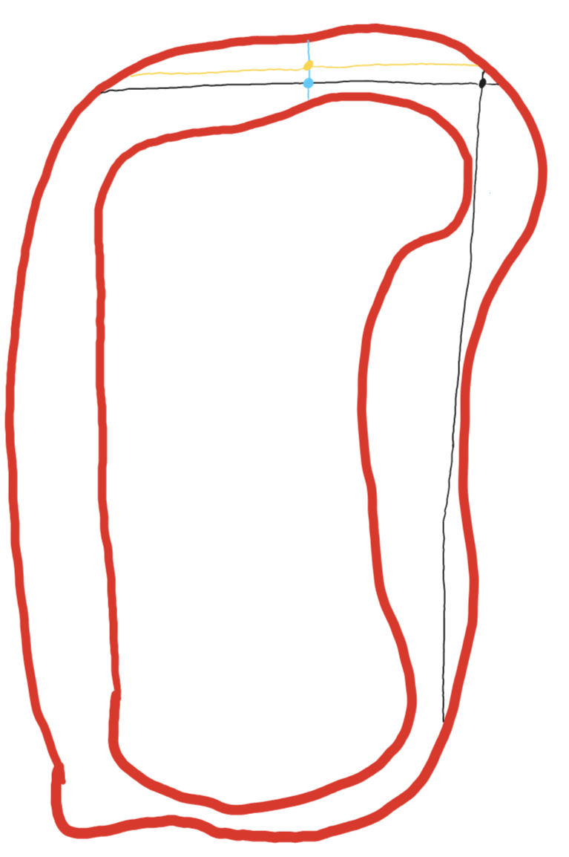
Centering to Find Epithelial Width
Pick a random point (black)
“Draw” lines parallel to axes through the point to the epithelium edges
Move to middle of shorter line (blue point)
Redo lines and move to middle of the shorter one (yellow point)
Cannot move from here — vertical line must be width
yeah i know the black line is not parallel with the y-axis, give me a break

Slide 19
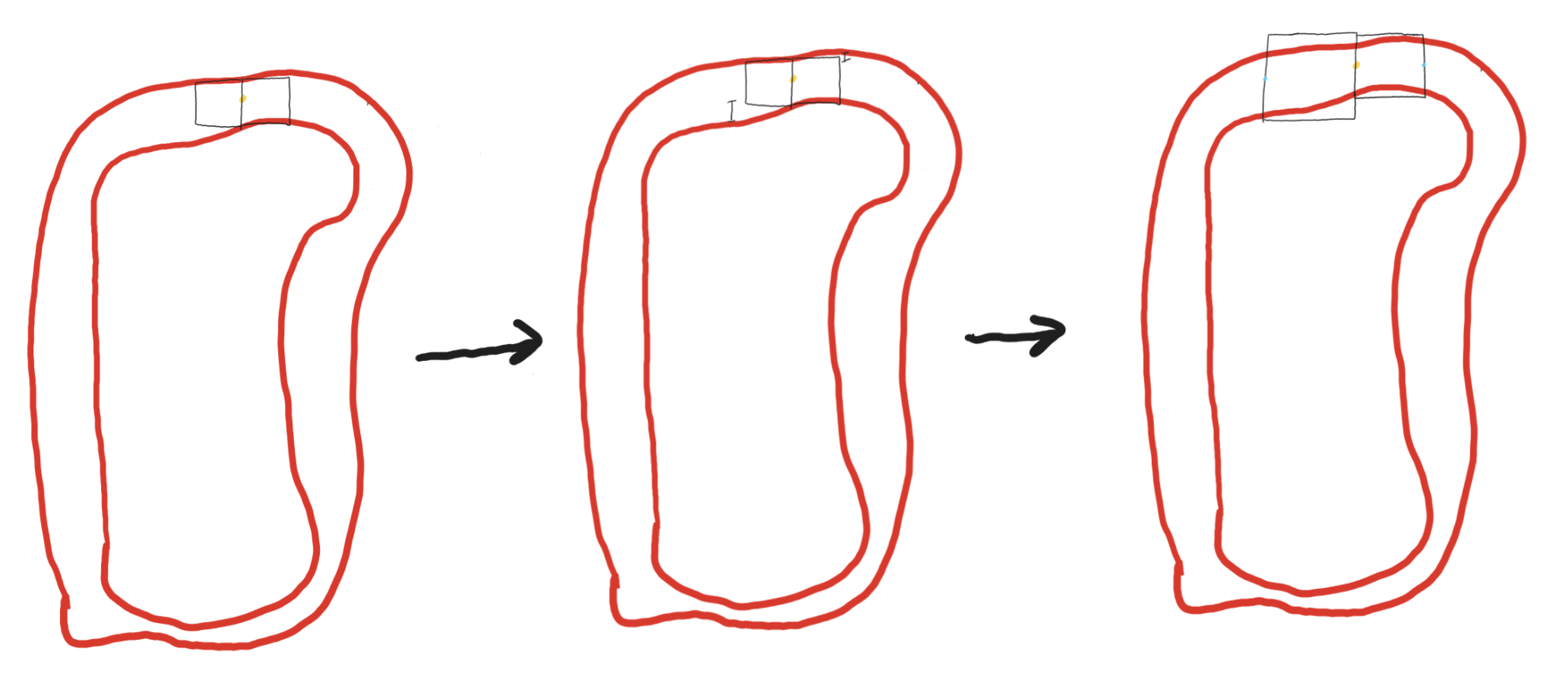
General Diagram of Algorithm in Full
da vinci would be so proud

Slide 20
Rotating Patches?
Played around with idea, thought it could increase coverage and lead to patches with less white space
What, algorithmically, would necessitate rotating a patch?
How would rotation be defined?
How to ensure rotated patches stay within constraints?
Ultimately, decided it’s not worthwhile
Adds computational complexity
Pixels don’t handle diagonal lines (non-45°) with precision
How does a pixel coordinate with a decimal work?
Not sure we’d want non-integer widths in the patch size distribution
Maintaining non x-/y-axis orientation through each new square complicates code

Slide 21
What’s Next?
Actually implementing algorithm
Run it on the same slices as our modified version of Alyssa’s algorithm
Determine which performs better and should be used to record the distributional data across the 106 patients

Slide 22
Adaptive Pooling and How it Works
Pooling is used after convolutional layers as a way to downsampling in order to reduce the size of intermediate features therefore the number of layers necessary
there are different types of pooling (max pooling takes the maximum value of the region while average pooling take the mean of the region)
Adaptive pooling is a pooling operation commonly used in convolutional neural networks (CNNs) that outputs a feature map of a fixed size, regardless of the input size. Unlike traditional pooling methods (e.g., max or average pooling) that reduce spatial dimensions by a fixed factor (e.g., 2x2 or 3x3) [3]
CNNs: a type of neural network designed for data that is spatially related (each input is related in some way to the inputs next to it) [2]
convolutional layer trains filters to understand relationships between neighboring data (ex- edge detector) and then stacks these layers on top of each other to build more vernal features from the previous layers features
Dynamically adjusts the pooling regions to ensure the output has predefined dimensions
Useful for handling variable-sized inputs in tasks like image classification
Works by dividing the input feature map into regions of nearly equal size and applying the pooling operation (e.g., max or average) on each region
Notes:
So once we have these patches we will use them to classify the image into the three classes we have. This will use CNNs and pooling to do so.
The layer adapts to the input size by calculating the size of the pooling window dynamically. This is done by dividing the input dimensions by the desired output dimensions. The pooling window size is then rounded up to the nearest integer to ensure that the output size matches the specified dimensions.

Slide 23
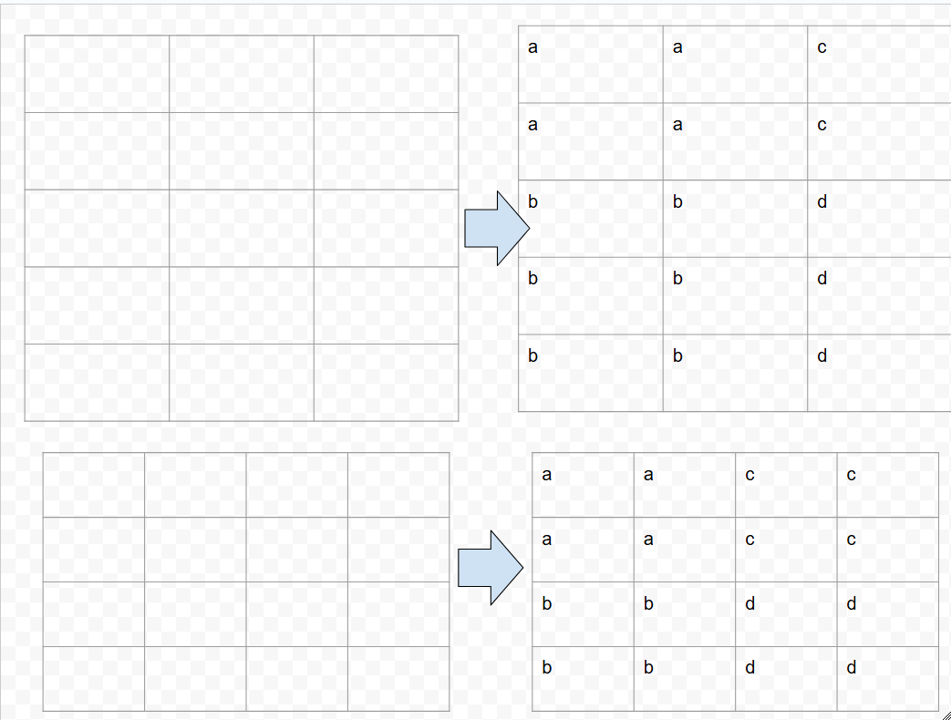
Adaptive pooling
Let's say we want to have a desired output of 2x2.
One of inputs is 3x5 other is 4x4
LOSS OF DIMENSIONALITY

Slide 24
The issue at hand
Should we try to minimize the number of distinct-sized patches to consider? Does having a higher number of patches it make the ML model more complex?
The ability to learn from various examples to strengthen model
Loss of information/misleading information creation
Probably some sort of convexity for trade off where we want to maximize the type and amount of observation for our model, cost of complexity, and also losing information/getting misleading information due to losing dimensionality
Cross validation could help calculate where the indifference point is on the curve

Slide 25
Implications of Multiple Patch Sizes
if amount of distinct sized patches is high, the model complexity increases because the network must handle varying feature sizes and learn the relationships across them [1]
more parameters may be required to integrate these features, which could cause an increase in training time and the risk of overfitting
more fragmented representation which complicates feature alignment between patches
increased computational cost due to needing to process these patches [4]

Slide 26
Implications of Minimal Patch Sizes
Fine details of an image may be lost especially in images with high-resolution detail that does not align well with the fixed patch size [3]
Poor adaptability to diverse image sizes because a single patch size might not capture useful features
reduces overfitting because all inputs are forced into a fixed patch size [6]
less flexible but more computationally efficient

Slide 27
Should we try to minimize the number of distinct-sized patches to consider?
Yes: most research papers I’ve read try to limit the number of distinct sized patches to consider to about 2-3
Does having a higher number of patches it make the ML model more complex?
Yes

Slide 28
Work Cited Page
1 - https://pmc.ncbi.nlm.nih.gov/articles/PMC6033561/ (Effect of patch size and network architecture on a convolutional neural network approach for automatic segmentation of OCT retinal layers)
2 - https://youtu.be/UzfRnZqPbCI?si=gJmhsHR8IrVWpHSk (How convolutional neural networks work)
3 - https://medium.com/@akp83540/adaptive-average-pooling-layer-cb438d029022#:~:text=In%20summary%2C%20Adaptive%20Average%20Pooling,output%20sizes%20for%20further%20processing. (Adaptive Average Pooling Layer)
4 - www.elsevier.com/locate/pr (Adaptive spatial pooling for image classification)
5 - www.elsevier.com/locate/knosys ( Multiview adaptive attention pooling for image–text retrieval)
6 - https://datascience.stackexchange.com/questions/96516/filter-size-in-cnns-and-how-they-relate-to-overfitting-underfitting (Filter size in CNNs and how they relate to overfitting/underfitting)

Slide 29
Appendix

Slide 30
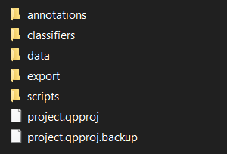
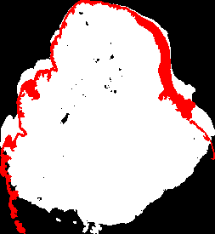
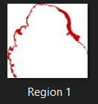
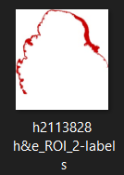
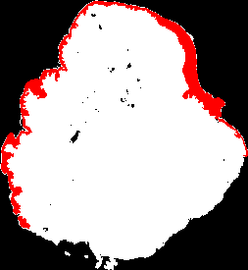
Instructions on what images to use with our patching algorithm
1: Take the mask png from the QuPath ‘annotations’ folder, not export

Slide 31
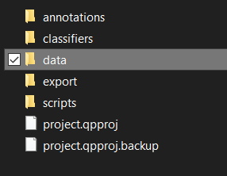
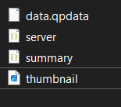
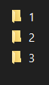
2: Use thumbnail file from QuPath for slice jpg. Do not convert TIF file to jpg directly.
Converting directly will give a file too big and cause the masking and patching to take too long

